Slide 1
Tutorial 5

Slide 2
Question 1: Realize the following functions using only a single 4-to-16 decoder (with active low output) and standard logic gates.
a) f(a, b, c, d) = Σ m(2,4,10,11,12,13)
b) F(A,B,C,D) = Π M (0, 1, 2, 5, 6, 7, 8, 9, 11, 12, 15)
Question 2: A logic function is expressed as F = Σm (0, 2, 5, 6, 7).
Design and implement the Boolean function F with a suitable decoder and an external OR/NOR gate having the minimum number of inputs.

Slide 3
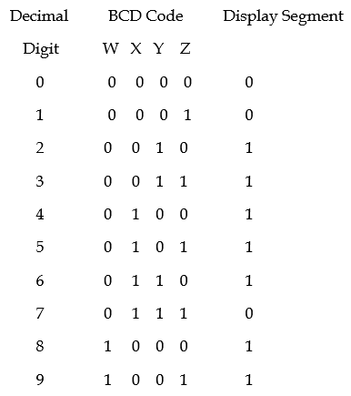
Question 3: A certain segment in a 7-segment display decoder has the truth table as follows:
Find the Boolean expression for the output,
allowing don’t care conditions. Can you guess
which segment this is?

Slide 4
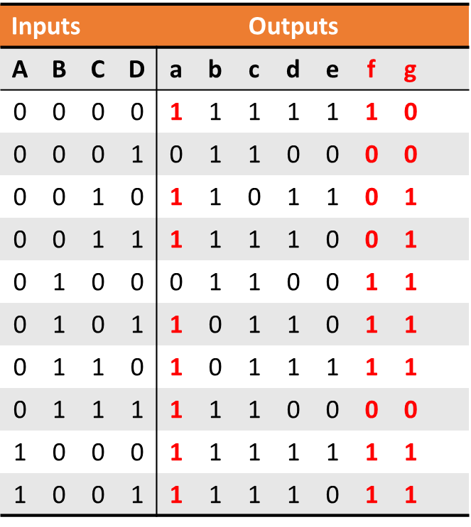
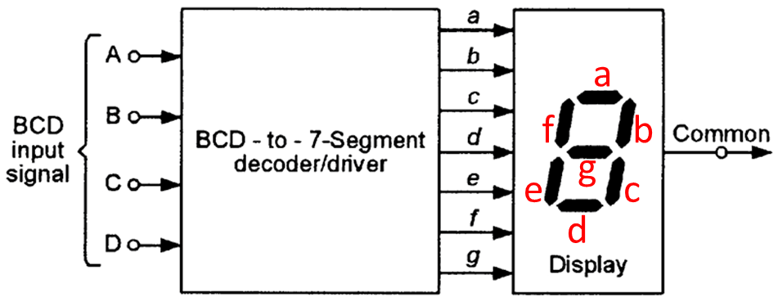
Question 4: Design a comparator circuit using different logic gates that can compare two 4-bit numbers.
Question 5: In a 7-segment display, each of the seven segments is activated for various digits as shown. Since each digit can be represented by a BCD code, derive the minimal Sum of Products (SOP) expression for segment f or g using the variables ABCD in order to design a decoder.

Slide 5
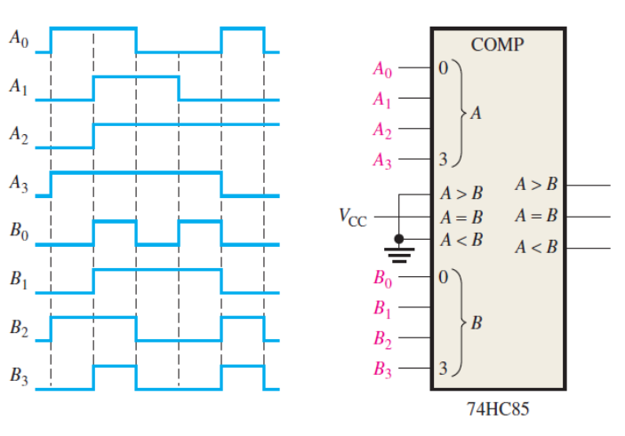
Question 6: For the 4-bit comparator in Figure, plot each output waveform for the input shown. The outputs are active HIGH.

Slide 6
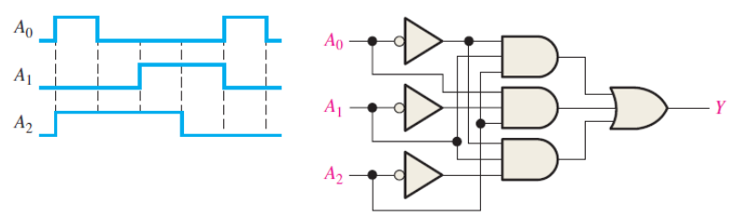
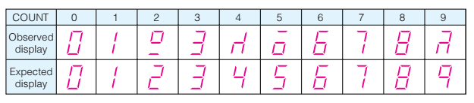
Question 7: Sketch the output waveform for the decoder in Figure if the inputs are given in the timing diagram.
Question 8: A logic designer wires the outputs from a BCD counter to the inputs of the decoder/driver of a 7 segment display. He applies pulses to the counter at a very slow rate and observes the LED display, as the counter counts up from 0000 to 1001. Examine this observed sequence carefully and try to predict the most probable fault.

